Slide 1

Further non-parametric tests
Dr Lee Barnby
School of Computing
7MA505 Statistical Methods 2
Week 8, Autumn Semester

Slide 2
Outline
Recap of last week
Worked examples with non-parametric tests
  Wilcoxon signed-rank test
  Two-sample Wilcoxon test
  Sign Test
Further tests for correlation and groups
Summary: How to choose your test

Slide 3
Recap
Introduced idea of Type I and II errors, power of a test
First look at non-parametric tests
  For use when assumptions about normality of underlying data may not be valid

Slide 4
Wilcoxon signed rank test: Cola example
A manufacturer of a cola claims that the average caffeine content in a bottle of their cola is 0.64.
The caffeine content of 16 randomly selected bottles of cola are given as follows:
Investigate the manufacturer’s claim
0.60 | 0.65 | 0.73 | 0.58 | 0.71 | 0.69 | 0.63 | 0.54
0.70 | 0.68 | 0.94 | 0.77 | 0.73 | 0.73 | 0.74 | 0.76

Slide 5
Cola example cont.
Data | Data - median
0.60 | -0.04
0.65 | 0.01
0.73 | 0.09
0.58 | -0.06
0.71 | 0.07
0.69 | 0.05
0.63 | -0.01
0.54 | -0.10
0.70 | 0.06
0.68 | 0.04
0.74 | 0.10
0.77 | 0.13
0.73 | 0.09
0.73 | 0.09
0.74 | 0.10
0.76 | 0.12
Ranked Data | Rank
0.01 | 1.5 (1)
-0.01 | 1.5 (2)
0.04 | 3.5 (3)
-0.04 | 3.5 (4)
0.05 | 5
-0.06 | 6.5 (6)
0.06 | 6.5(7)
0.07 | 8
0.09 | 10 (9)
0.09 | 10 (10)
0.09 | 10 (11)
0.10 | 13 (12)
-0.10 | 13 (13)
0.10 | 13 (14)
0.12 | 15
0.13 | 16
Follow the steps…
Subtract the hypothesized mean
Rank data according to absolute value
Tied data get equal average rank
  E.g 1.5 for first two values
Calculate T₊ and T₋
  T₋ = 26.5, T₊ = 109.5

Slide 6
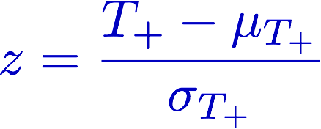

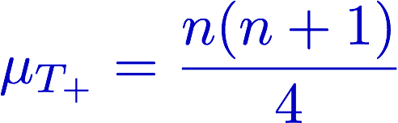
Cola example cont.
Of course you can use R with the wilcox.test() command
R
qsignrank(0.025,16)
> 30
Choose smaller of T₊ and T₋ compare to tables:
  5% value = 30
Reject/Accept H₀ at 5% level
Or use normal approximation
Where:
R
psignrank(24.5,16)
> 0.01248169

Slide 7
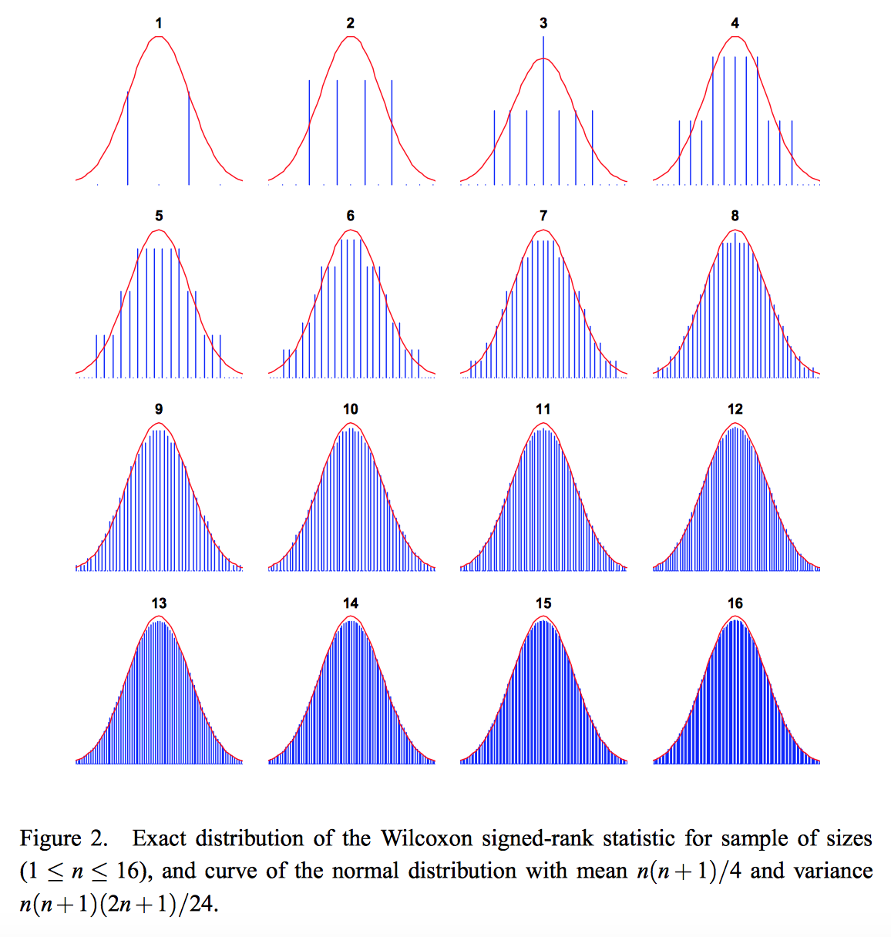
Normal approximation
Where does it come from? Calculated by considering number of ways of achieving a ranking sum for n data points
Carine A. Bellera, Marilyse Julien & James A. Hanley (2010) Normal Approximations to the Distributions of the Wilcoxon Statistics: Accurate to What N? Graphical Insights, Journal of Statistics Education, 18:2
https://doi.org/10.1080/10691898.2010.11889486 (Open Access)

Slide 8
Two-sample Wilcoxon test: Car mileages
Also called the Mann-Whitney test
Mileage performance tests were conducted for two models of car
Twelve of each model were randomly selected and the miles per gallon rating for each model was developed based on 1000 miles of motorway driving
Model 1 | 20.6 | 18.9 | 18.6 | 18.9 | 18.8 | 20.2 | 21.0 | 20.5 | 19.8 | 19.8 | 19.2 | 20.5
Model 2 | 16.3 | 18.6 | 16.4 | 16.5 | 17.7 | 21.1 | 16.3 | 17.8 | 16.8 | 15.9 | 17.0 | 19..1

Slide 9
Model 1 | 20.6 | 18.9 | 18.6 | 18.9 | 18.8 | 20.2 | 21.0 | 20.5 | 19.8 | 19.8 | 19.2 | 20.5
Model 2 | 16.3 | 18.6 | 16.4 | 16.5 | 17.7 | 21.1 | 16.3 | 17.8 | 16.8 | 15.9 | 17.0 | 19..1
15.9 | 16.3 | 16.3 | 16.4 | 16.5 | 16.8 | 17.0 | 17.7 | 17.8 | 18.6 | 18.6 | 18.8
1 | 2.5 | 2.5 | 4 | 5 | 6 | 7 | 8 | 9 | 10.5 | 10.5 | 12
18.9 | 18.9 | 19.1 | 19.2 | 19.8 | 19.8 | 20.2 | 20.5 | 20.5 | 20.6 | 21.0 | 21.1
13.5 | 13.5 | 15 | 16 | 17.5 | 17.5 | 19 | 20.5 | 20.5 | 22 | 23 | 24
Sum of ranks of model 1, T₁ = 205.5
Sum of ranks of model 2, T₂ = 94.5
Check T₁ + T₂ = 300
n(n+1)/2 for n=24 is 300

Slide 10
Car mileages cont.
Define hypotheses
H₀
H₁
Combine the data and rank them
Sum ranks for samples 1 and 2 separately to get T₁ and T₂

Slide 11
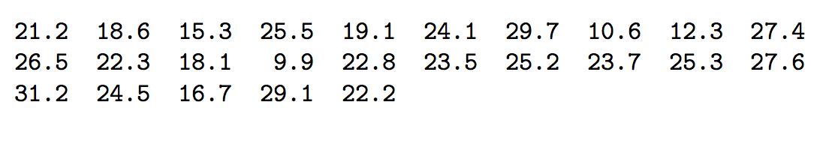
Sign Test: Social media habits
The Sign Test is used to test stated values of the median.
If the population can be assumed to be fairly symmetric about the mean then the test can be used to test values of the mean.
A magazine claims that teenagers engage with social media for no more than 20 hours per week. Data:

Slide 12
Social media cont.
If the population can be assumed fairly symmetric, then 50% of the population will be less than the median (mean), etc.
A one-sample test can be used to test the null hypothesis that the percentage of values above (or below) the mean is 50
A sign is attached to each value in the sample
  + if the value is above the asserted value
  − if the value is below
the sum of the rankings of positive deviations, V⁺
the sum of the rankings of negative deviations, V⁻

Slide 13
25 data points
8 are below 20
17 are above 20
Calculate the probability of the extreme outcome: P(8/25) = 0.032
However we need to add the more extreme outcomes: P(7/25), P(6/25) … P(0/25)
P ( ≤ 8 from 25 trials) = 0.054

Slide 14
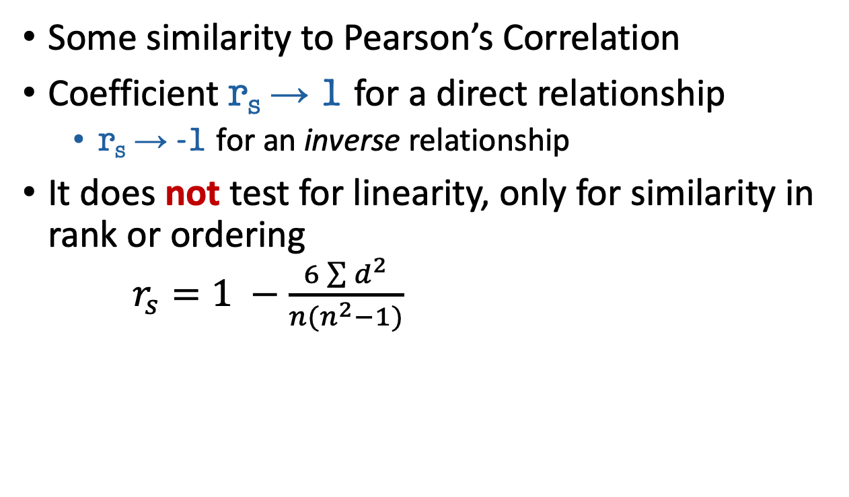
Spearman’s Rank Correlation Coefficient
Some similarity to Pearson’s Correlation
Coefficient r_{s} → 1 for a direct relationship
  r_{s} → -1 for an inverse relationship
It does not test for linearity, only for similarity in rank or ordering
$r_{s}=1 −\frac{6\sum{d^{2}}}{n(n^{2}−1)}$
Some examples of distributions and their r_{S} values are shown at:
https://www.nagwa.com/en/explainers/412129796494/

Slide 15
Alternatives to one-way ANOVA
One may need these if the data are not normal or the variances are unequal.
  See interesting discussion at: https://stats.stackexchange.com/questions/91872/alternatives-to-one-way-anova-for-heteroskedastic-data

Slide 16
Kruskal Wallis Test
Analogue of ANOVA parametric test
Determines whether three or more groups have the same medians
Assumptions:
  observations in the data set are independent of each other
  the distributions of the population are not necessarily normal
  variances should not be necessarily equal
  observations must be drawn from the population by random sampling
The sample sizes in the Kruskal-Wallis test should be as equal as possible, but some differences are allowed
Data from k groups are ordered and ranks assigned
Average ranks of groups are compared

Slide 17
Summary: How to choose your test
Parametric Test | Non-Parametric test
Paired t-test | Wilcoxon Rank sum Test
Unpaired t-test | Two-sample Wilcoxon (Mann-Whitney)
Pearson Correlation | Spearman Correlation
One-way analysis of variance (ANOVA) | Kruskal Wallis Test

